Slide 1
Poetry Techniques
imagery
rhythm
rhyme
repetition
alliteration
onomatopoeia

Slide 2
What are the following techniques?
Onomatopoeia–
Rhyme-
Repetition-
Rhythm-
Imagery-
Alliteration-

Slide 3

Poetry Terms
Onomatopoeia- the use of words which sound like the thing that they represent
E.g. buzz, bang
Rhyme - when words sound the same
E.g. mat, cat, bat
Repetition - words/phrases repeated near each other
Rhythm - the beat of a poem
Imagery - the pictures in the poem
Alliteration- when words in a poem/sentence(s) start with the same letter

Slide 4
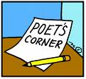
Alliteration
When words in a poem start with the same letter, it is called alliteration.
Example: She sells sea shells on the sea shore.
The bubbles boiled at the brim.

Slide 5

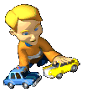

Stan the strong surfer saved several swimmers on Saturday.
Tiny Tommy Thomson takes toy trucks to Timmy’s on Tuesday.
Click here to read more alliterations.

Slide 6

Tongue-twisters
Can you invent some tongue-twisters using alliteration?
Silly sisters........
Bold brothers......
Lovely lollipops......
Tough teachers......
Fabulous football......
Miserable Mondays......
Zany zebras......
Comfy couches.....

Slide 7

Now you try!
Let’s look at the poem ‘Windy Nights’
by Robert Louis Stevenson

Slide 8
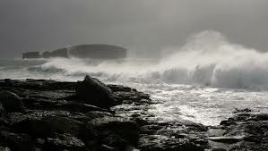
Windy Nights
Whenever the moon and stars are set,
Whenever the wind is high,
All night long in the dark and wet
A man goes riding by.
Late in the night when the fires are out,
Why does he gallop and gallop about?
Whenever the trees are crying aloud?
And the ships are tossed at sea,
By, on the highway, low and loud,
By at the gallop goes he.
By at the gallop he goes, and then
By he comes back at the gallop again.
by Robert Louis Stevenson

Slide 9
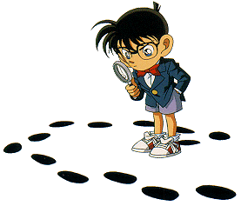
Be a detective!
Group 1: Alliteration in the poem
Group 2: Rhyme in the poem
Group 3: Imagery in the poem
Group 4: Onomatopoeia in the poem
Group 5: Rhythm in the poem
Group 6: Repetition in the poem

Slide 10
Do you know your techniques?
Find an example of…
Onomatopoeia–
Rhyme-
Repetition-
Rhythm-
Imagery-
Alliteration-

Slide 11
Homework
Design a poster using alliteration.

Slide 12
